Slide 1
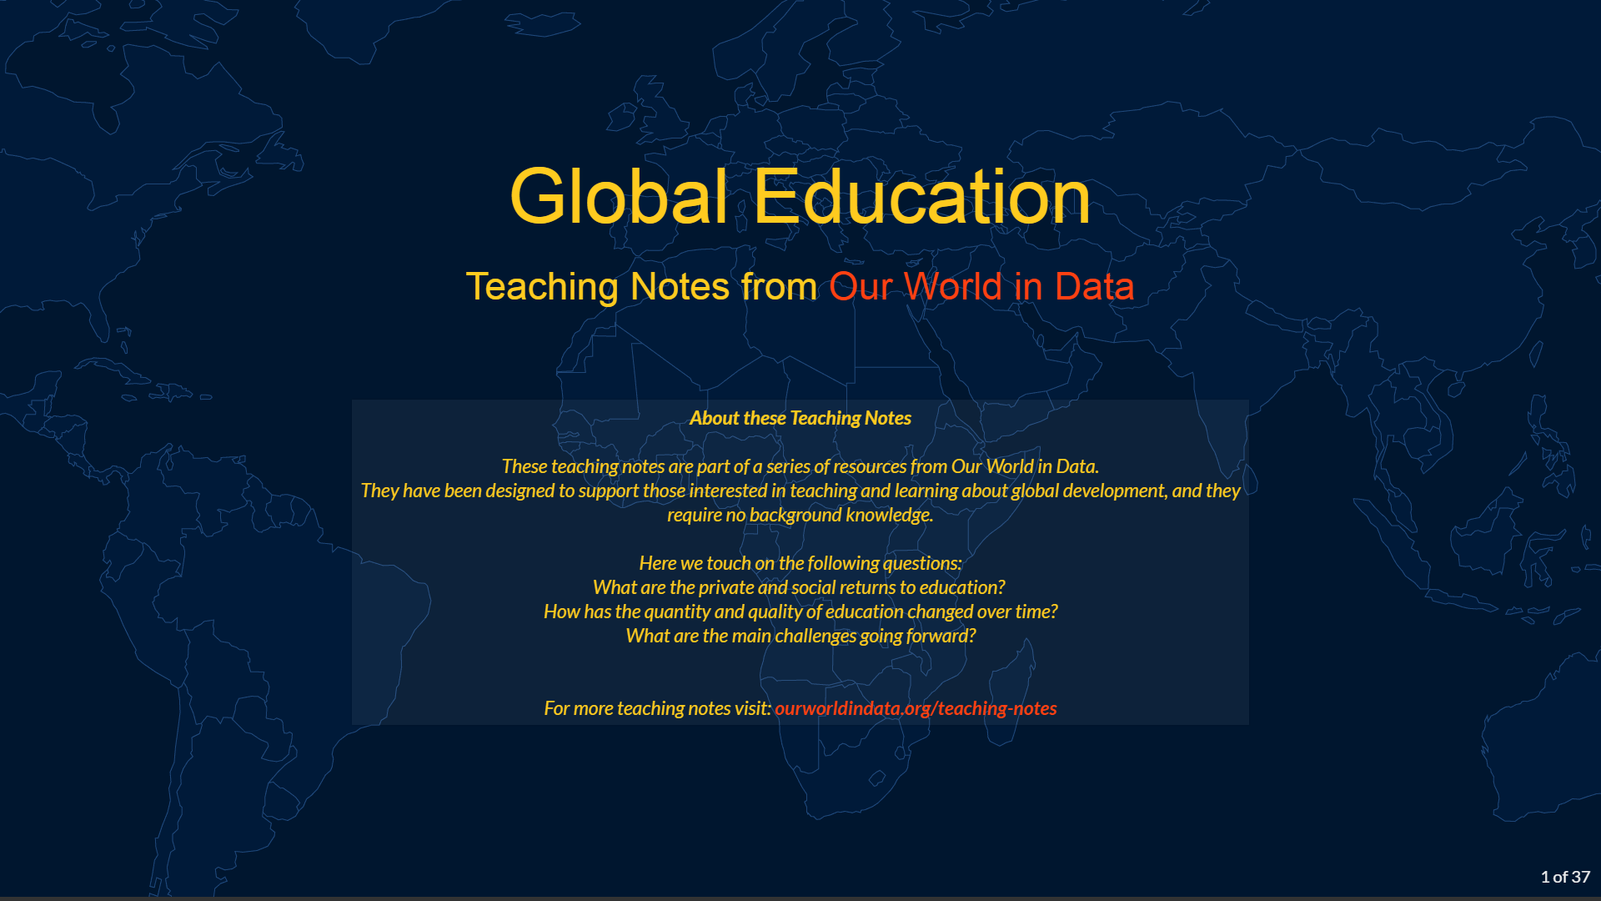

Slide 2
Outline
What are the private and social returns to education?
How has access to education changed over time?
What are the main challenges going forward?

Slide 3
Education helps individuals be more productive and get better-paid jobs

Slide 4
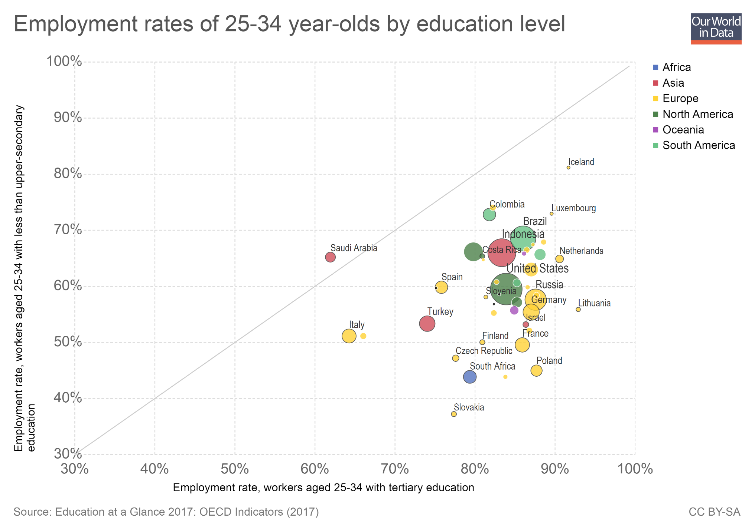
In most countries, employment rates tend to be higher among adults with advanced education degrees. This chart shows this: It compares employment rates among workers with a high school degree (upper secondary education) against those with more advanced qualifications (tertiary education).
All countries in this dataset are below the diagonal parity line (except for Saudi Arabia where the labor market is very particular). This means they have higher employment rates among those who are more educated.
In some countries the differences are very large. In Slovakia, for instance, the employment rate for those with tertiary education is twice as large as the rate for those with secondary education.
(Note: You can read more about how educational attainment is linked to labor market outcomes in the OECD report Education at a Glance 2017.)

Slide 5
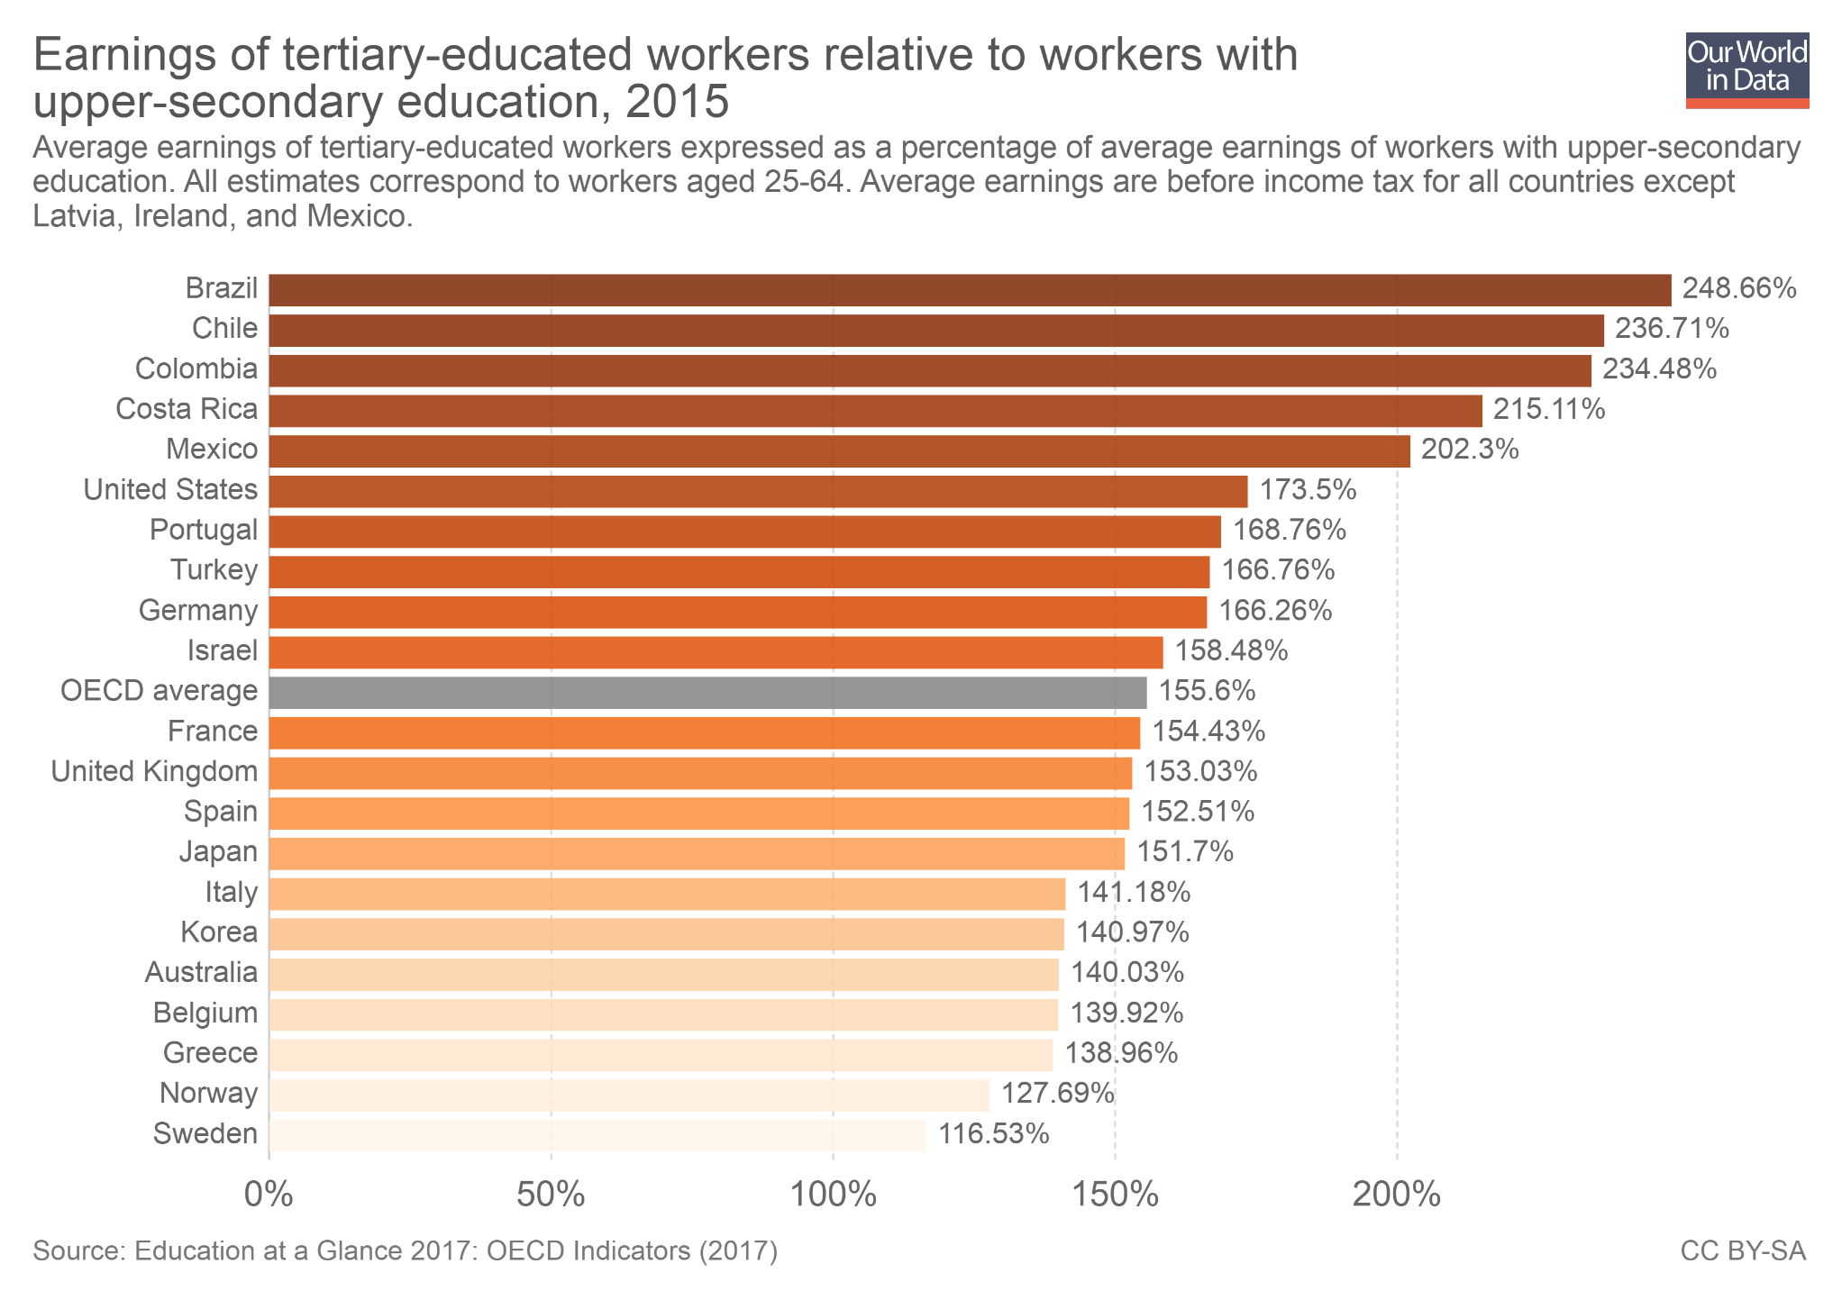
People with more education tend to also have higher earnings when they are employed. The correlation is shown in this chart, where the bars represent earnings of tertiary-educated workers relative to the earnings of workers with a high school degree (upper secondary education).
As we can see, in Brazil, Mexico, Colombia, Costa Rica and Chile, those with advanced degrees earn more than twice as much as those with high school degrees. The average for the OECD shows an earning advantage of around 55%.
Individuals with more education are different in many ways to individuals with less education, so we cannot attribute wage differences in this chart solely to education. But many careful econometric studies have shown that education does lead to higher earnings. You can read more about the causal effect of education on earnings here.

Slide 6
Education quality and economic growth tend to go together

Slide 7
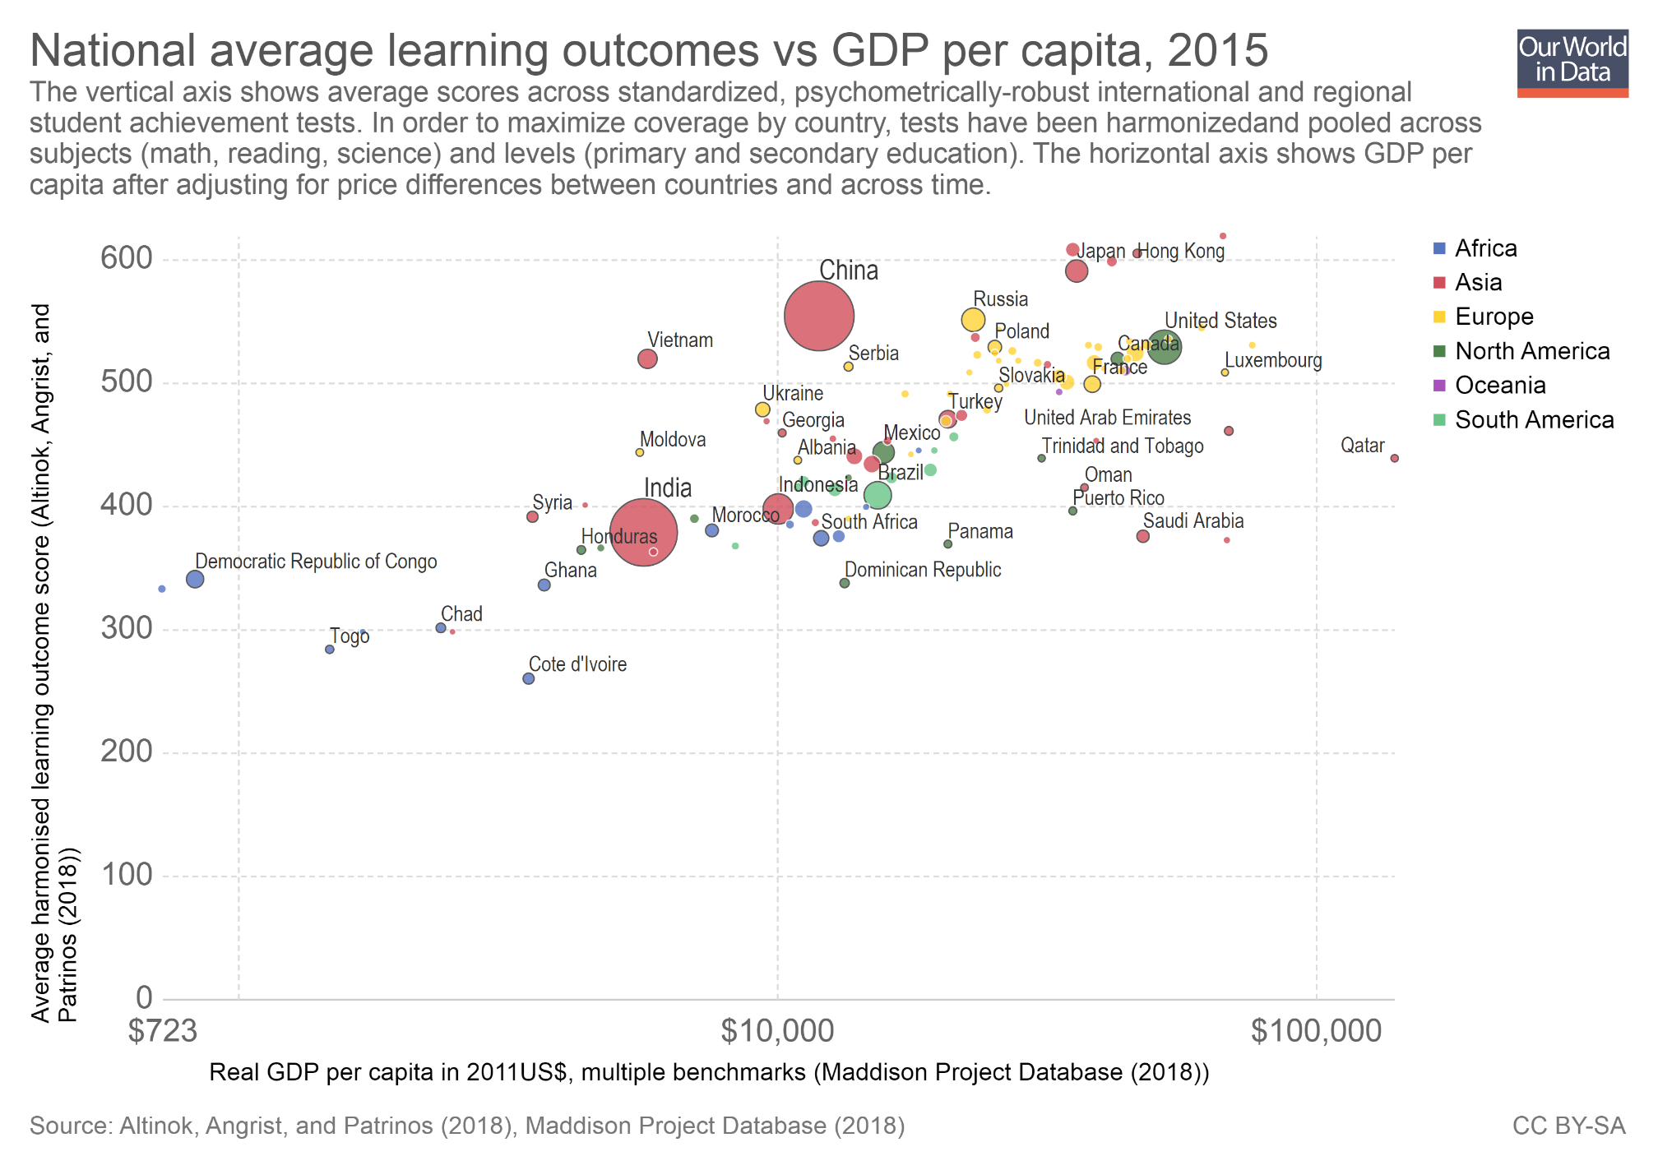
This chart plots GDP per capita against student test scores, which are a proxy for acquired skills.
It shows a positive correlation: richer countries tend to have higher average student test scores.
Using the slider at the bottom of the chart, you can check that there is also a similar correlation over time: economic growth and improvements in education tend to go together.
This is just a raw correlation between the two variables; but there is evidence that education quality correlates with economic growth, even after accounting for other variables, such as baseline levels of schooling and economic activity.
(Note: In the academic literature, there are not many studies that have been able to pin down the size of the causal impact that education has on economic growth. This is both because establishing causality at the macro level is difficult, and because we are only starting to get reliable data on skills and learning outcomes. You can read more about this in our blog post here.)

Slide 8
Education also has positive spill-over effects on society

Slide 9
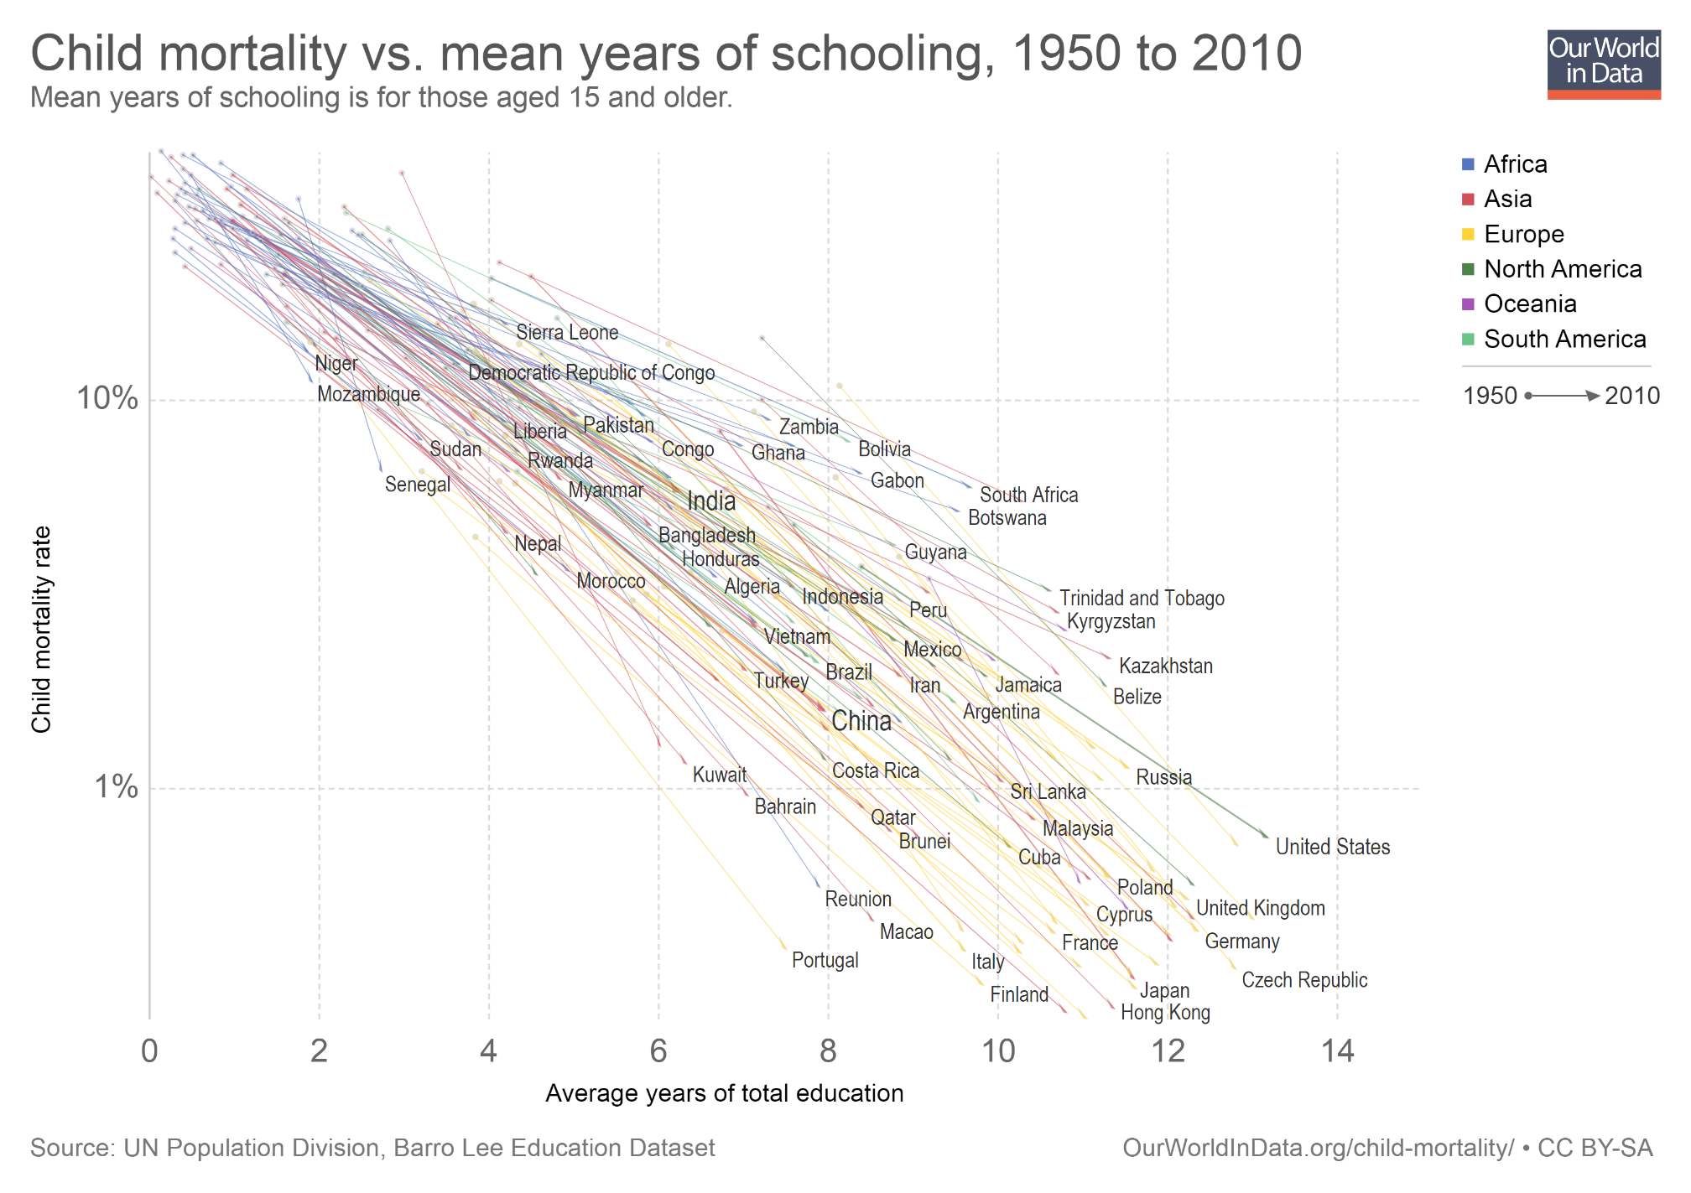
If one person has access to education, this has a positive effect on other people. Economists call these spill-over effects "externalities".
For example, women’s education leads to lower child mortality because it contributes towards healthier habits and choices, including child spacing.
This chart shows the strong correlation between child mortality and educational attainment, across countries and time.
Each line in this plot represents a country. The horizontal axis shows average years of schooling, while the vertical axis shows child mortality rates. Countries with more education tend to have lower child mortality; and across time, increasing education tends to go together with lower child mortality.
(Note: You can read more about the causal effect of education on child mortality in our entry here.)

Slide 10
Outline
What are the private and social returns to education?
How has access to education changed over time?
What are the main challenges going forward?

Slide 11
The number of people who can read and write has grown remarkably over the last couple of centuries

Slide 12
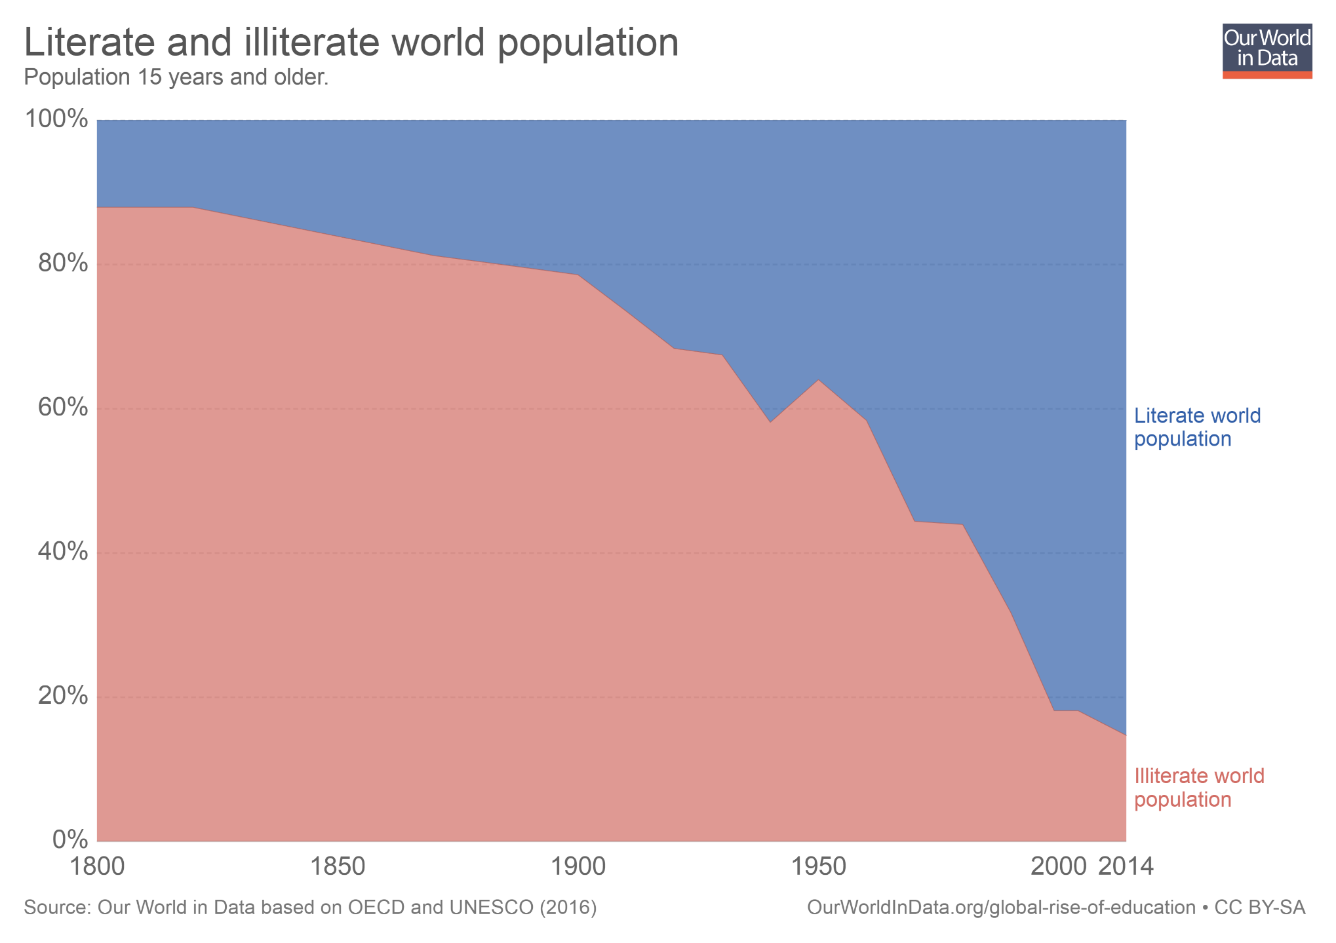
This chart shows estimates of world literacy from 1800 to 2014. As we can see, over the last two centuries the share of illiterate adults has gone down from 88% to less than 15%.
Literacy rates grew constantly but rather slowly until the beginning of the twentieth century – but growth accelerated sharply after the middle of the 20th century, when the expansion of basic education became a global priority.
(Note: You can read more about how literacy is measured here. And you can find more data and analysis on the expansion of literacy in our entry here.)

Slide 13
School enrollment has also increased substantially

Slide 14
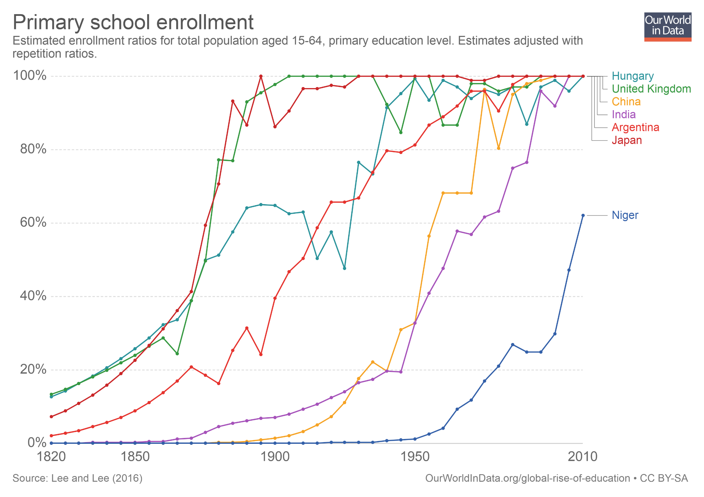
This chart shows estimates of enrollment in primary schools around the world over the last two centuries.
The option 'Add country' allows you to plot estimates for most countries.
As you can check, attending a primary school was rare everywhere in the world. Today the situation is very different.
Some gaps in enrollment remain, especially in poor countries. But from a historical perspective, school enrollment is much, much higher everywhere today.
The expansion in school enrollment has implied a substantial decline in the number of children of primary-school age who are not in school.
(Note: You can read more about progress and challenges in primary-school education in our entry here.)

Slide 15
There has been an increase in years of schooling beyond the primary level

Slide 16
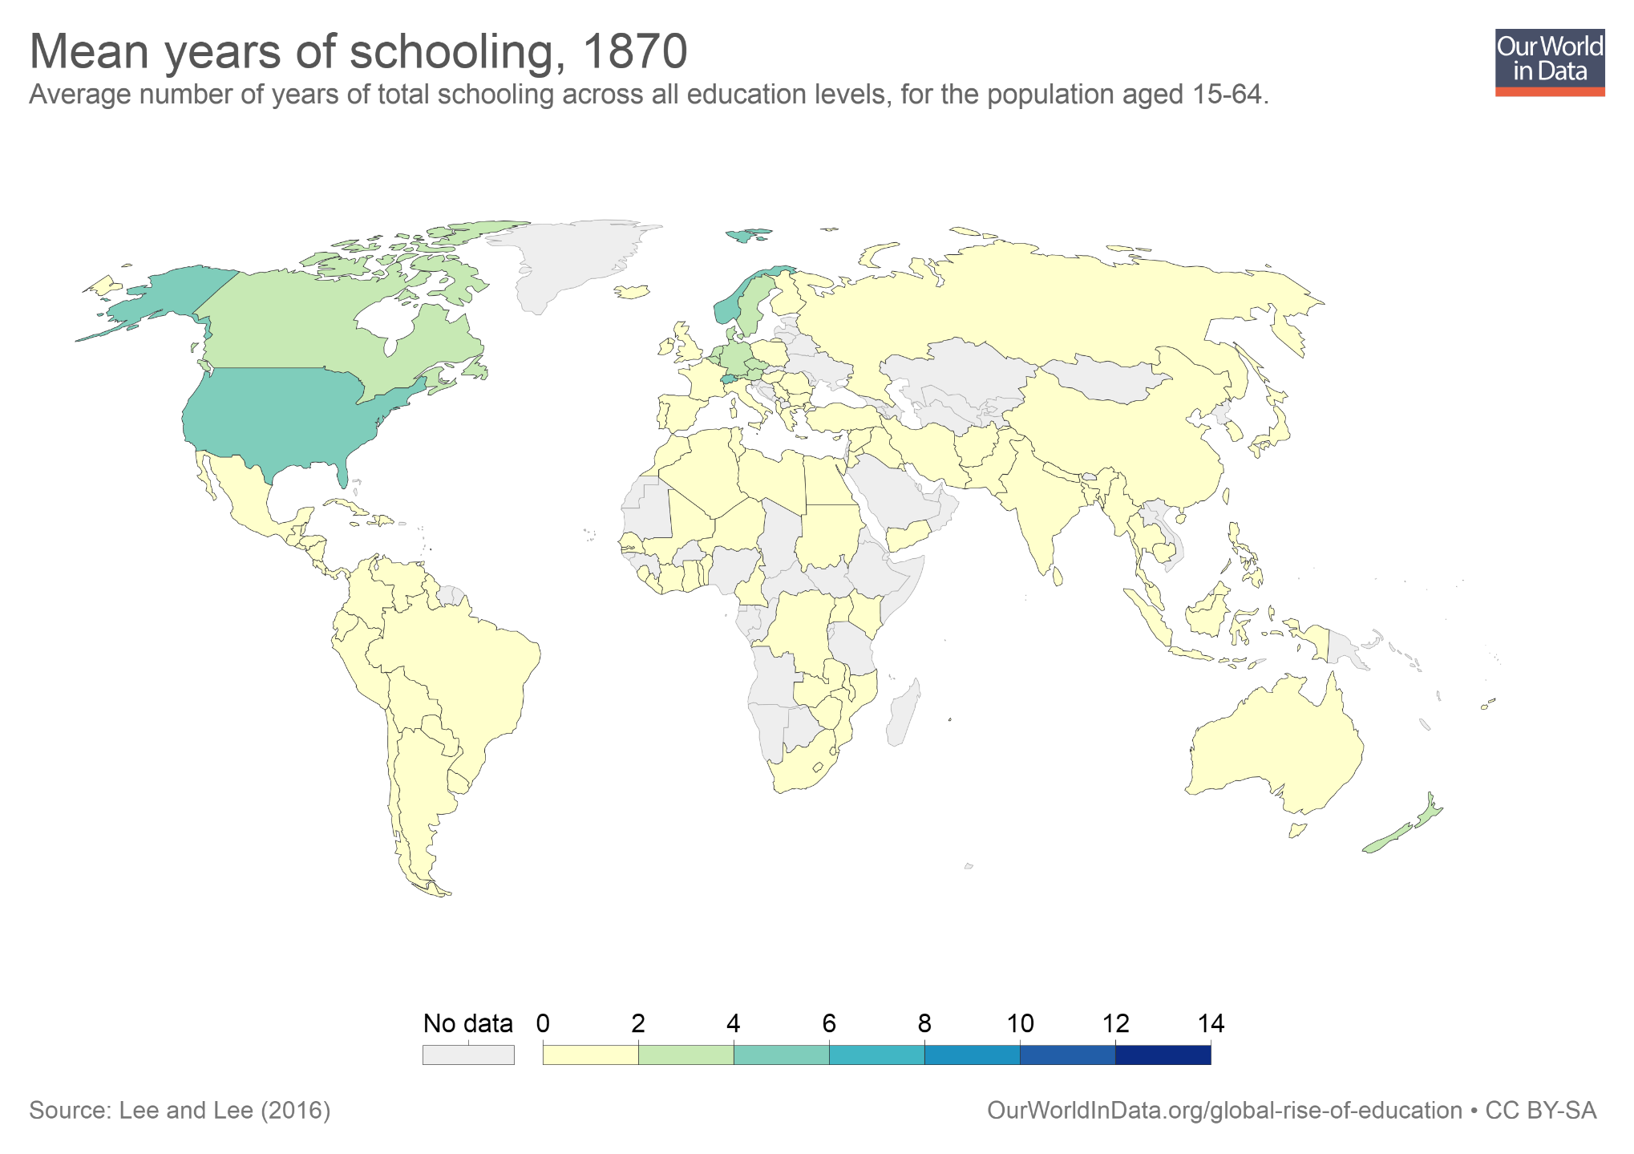
The 'average years of schooling' is a measure of the quantity of education in a population.
This map shows historical estimates of average years of schooling around the world in 1870.
If you press 'play', in the bottom left corner, you'll see the evolution of this variable, from 1870 to 2010. This reveals the progress that has been achieved: The picture in 2010 is completely different.
You can read more about the global expansions of education in our entry here.
(Note: In the interactive version of this chart it is also possible to click on any country to see the change over time.)

Slide 17
The expansion of education in terms of access to schooling is a great achievement. But schooling is not the same as learning.

Slide 18
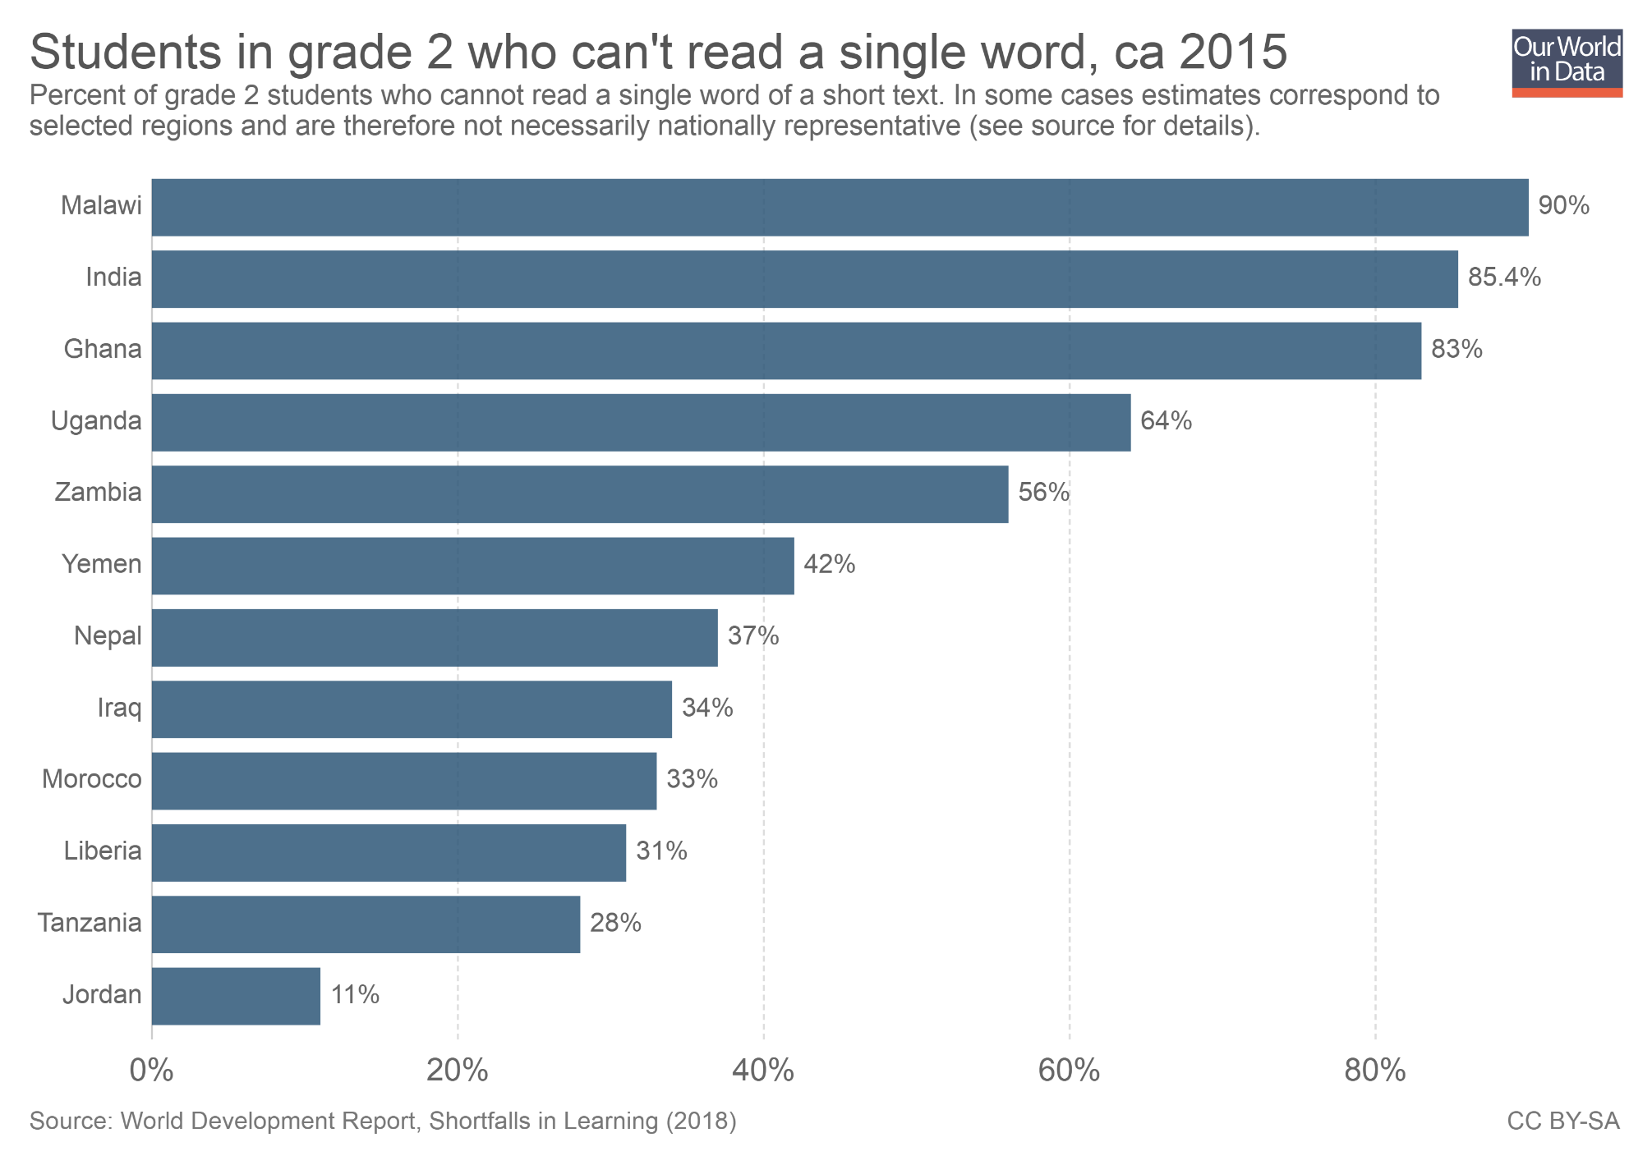
This bar chart shows that in some countries going to school does not necessarily mean that the students actually learn. In Ghana, India, and Malawi more than 4 out of 5 students in second grade are not able to read a single word.

Slide 19
Available data on international learning outcomes shows that students in poor countries are often lagging behind

Slide 20
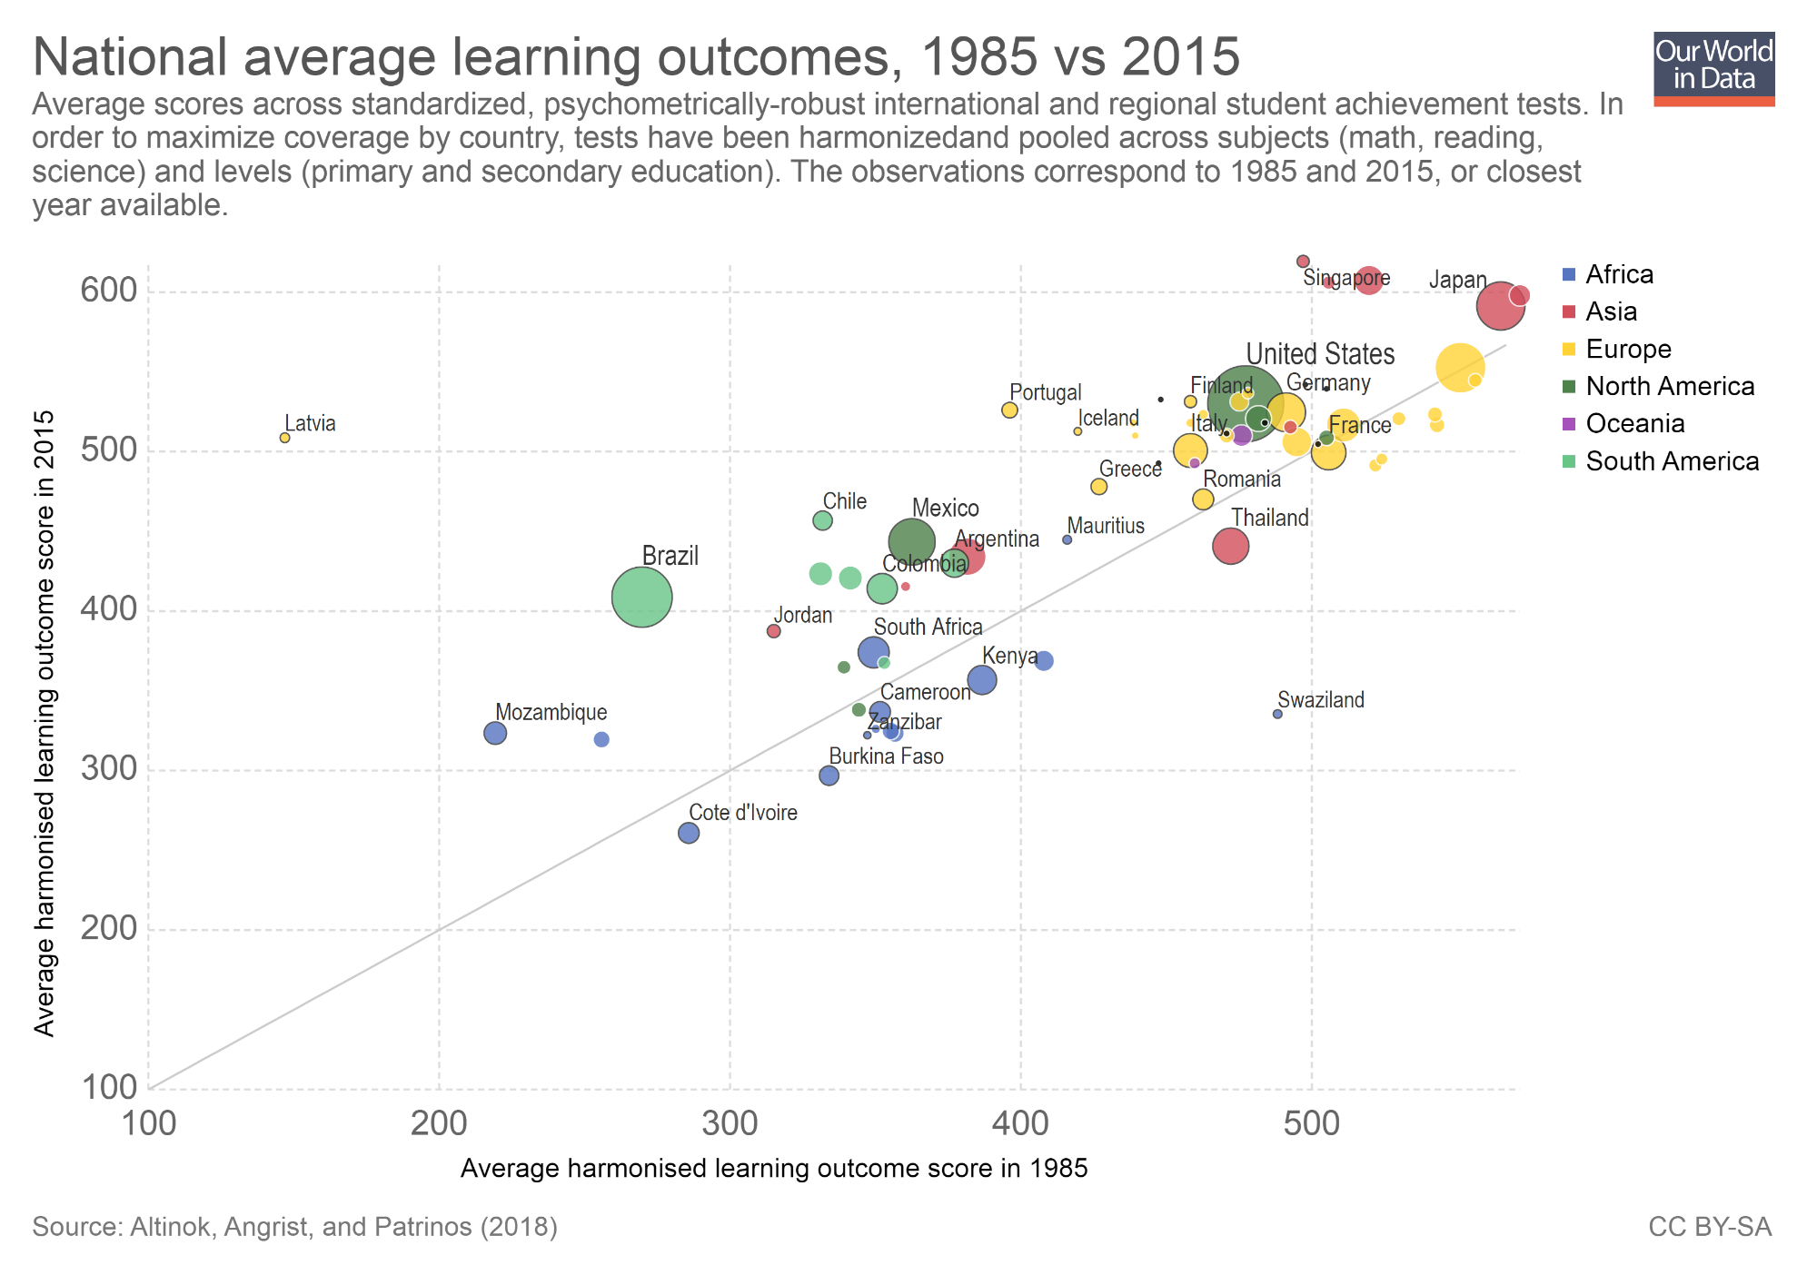
This chart compares average scores on standardized tests across countries (tests are harmonized, so that outcomes are comparable across countries and time).
The vertical axis shows student outcomes in 2015, while the horizontal axis shows outcomes in 1985.
As we can see, most countries have seen improvement in scores (most bubbles are above the diagonal parity line). But disparities are large, and in Sub-Saharan Africa scores today are very low (they are further down in the vertical axis), and there is little progress (most blue bubbles are below the diagonal line).
(Note: You can read more about education quality in our entry here.)

Slide 21
Within poor countries, learning outcomes tend to be even lower for students from the poorest households

Slide 22
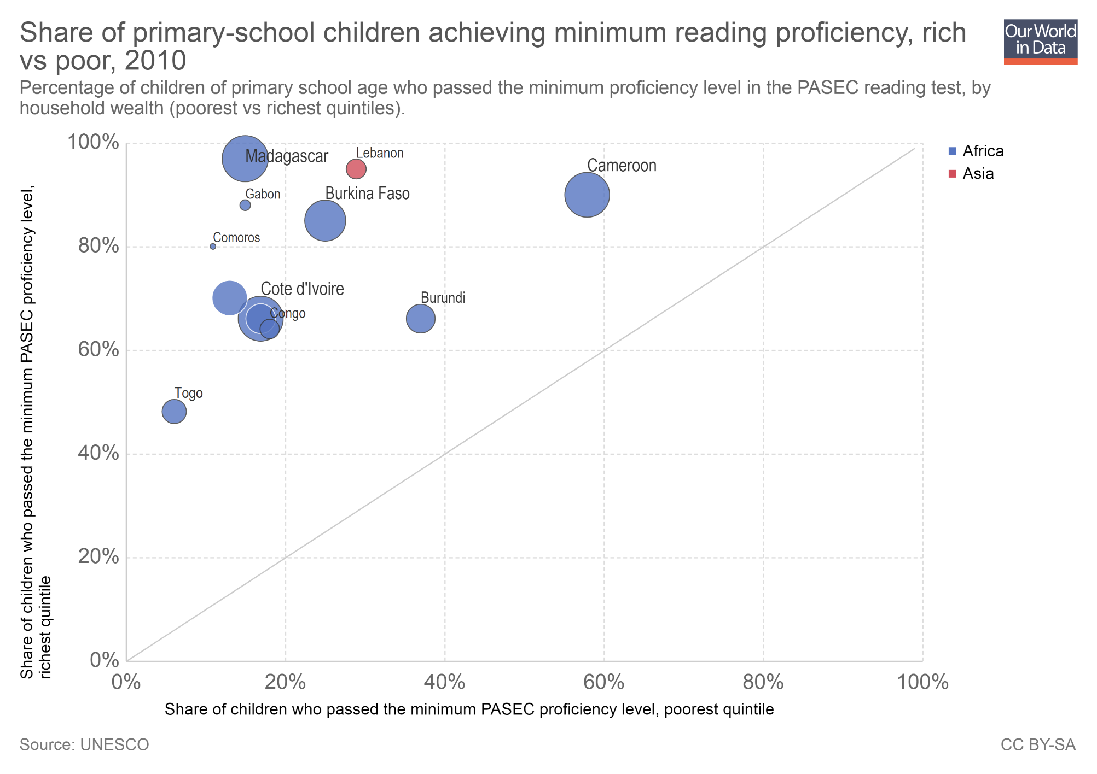
This chart shows the percentage of children of primary school age passing the minimum proficiency level in a standardized reading test, among poor and rich households.
As we can see, all countries are above the diagonal parity line. This means that attainment is much lower among the poorest households.
(Note: You can read more about the challenges of poor education quality in the World Development Report 2018, and you can find more data on inequalities within and across countries from the Global Education Monitoring Report.)

Slide 23
Outline
What are the private and social returns to education?
How has access to education changed over time?
What are the main challenges going forward?

Slide 24
Teachers often have to teach very large groups

Slide 25
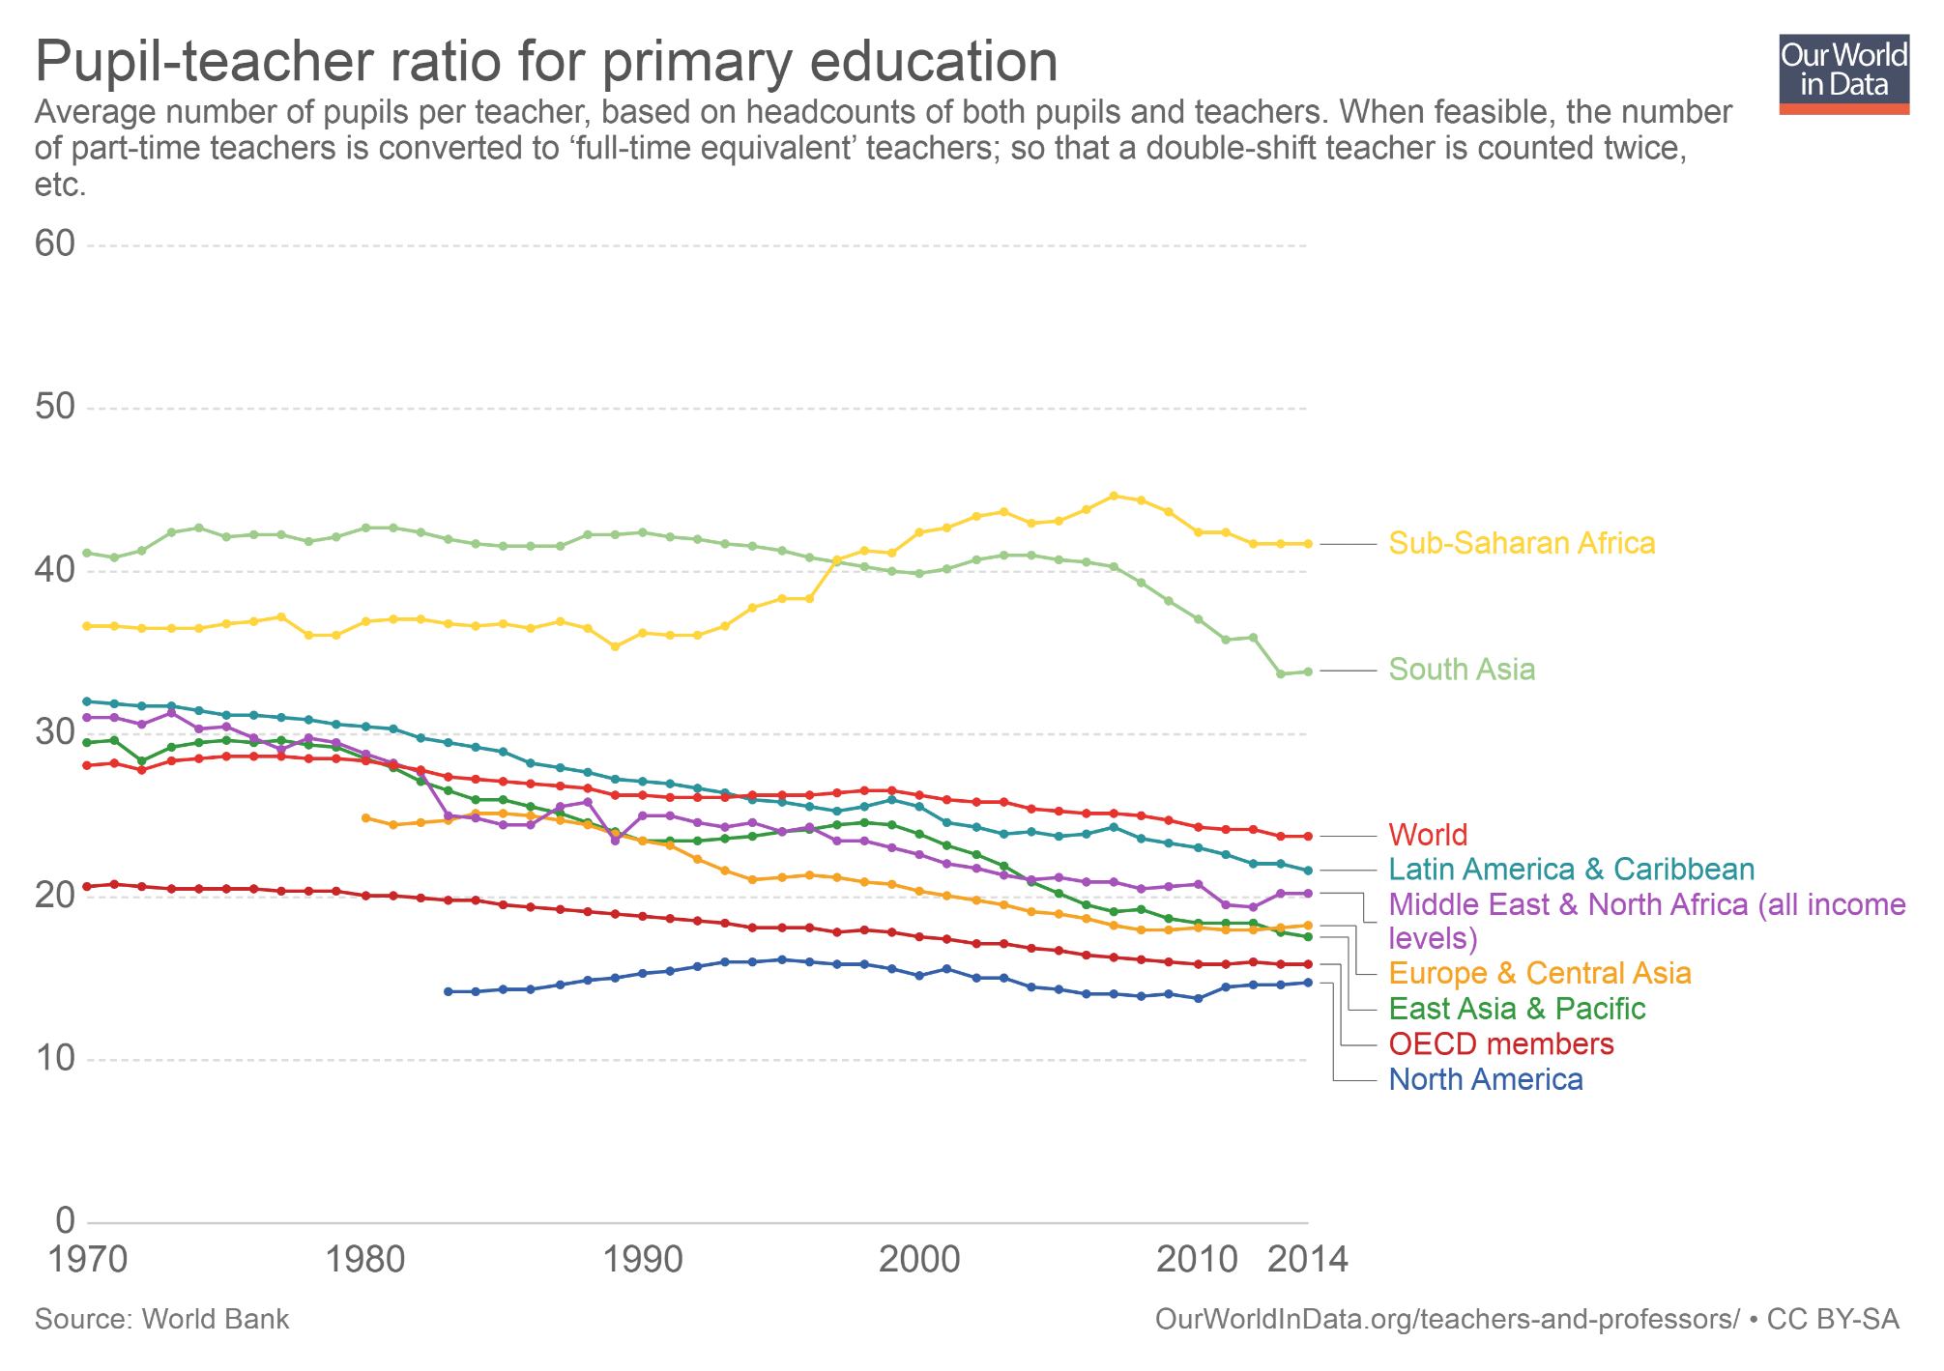
In Sub-Saharan Africa the average number of pupils per teacher in primary education is higher today than two decades ago.
You can use the option 'Add Country', or you can click on the 'Map' tab to explore cross-country differences in pupil-teacher ratios.
As you can check, in Norway and Sweden there are on average 9 primary-school students per teacher. In the Central African Republic, there are about 80.
Simply increasing the number of teachers is not sufficient to improve learning outcomes. But it is important to recognize that in many contexts, the availability of teachers remains a binding constraint.

Slide 26
Teachers are often not qualified or trained to do their job

Slide 27
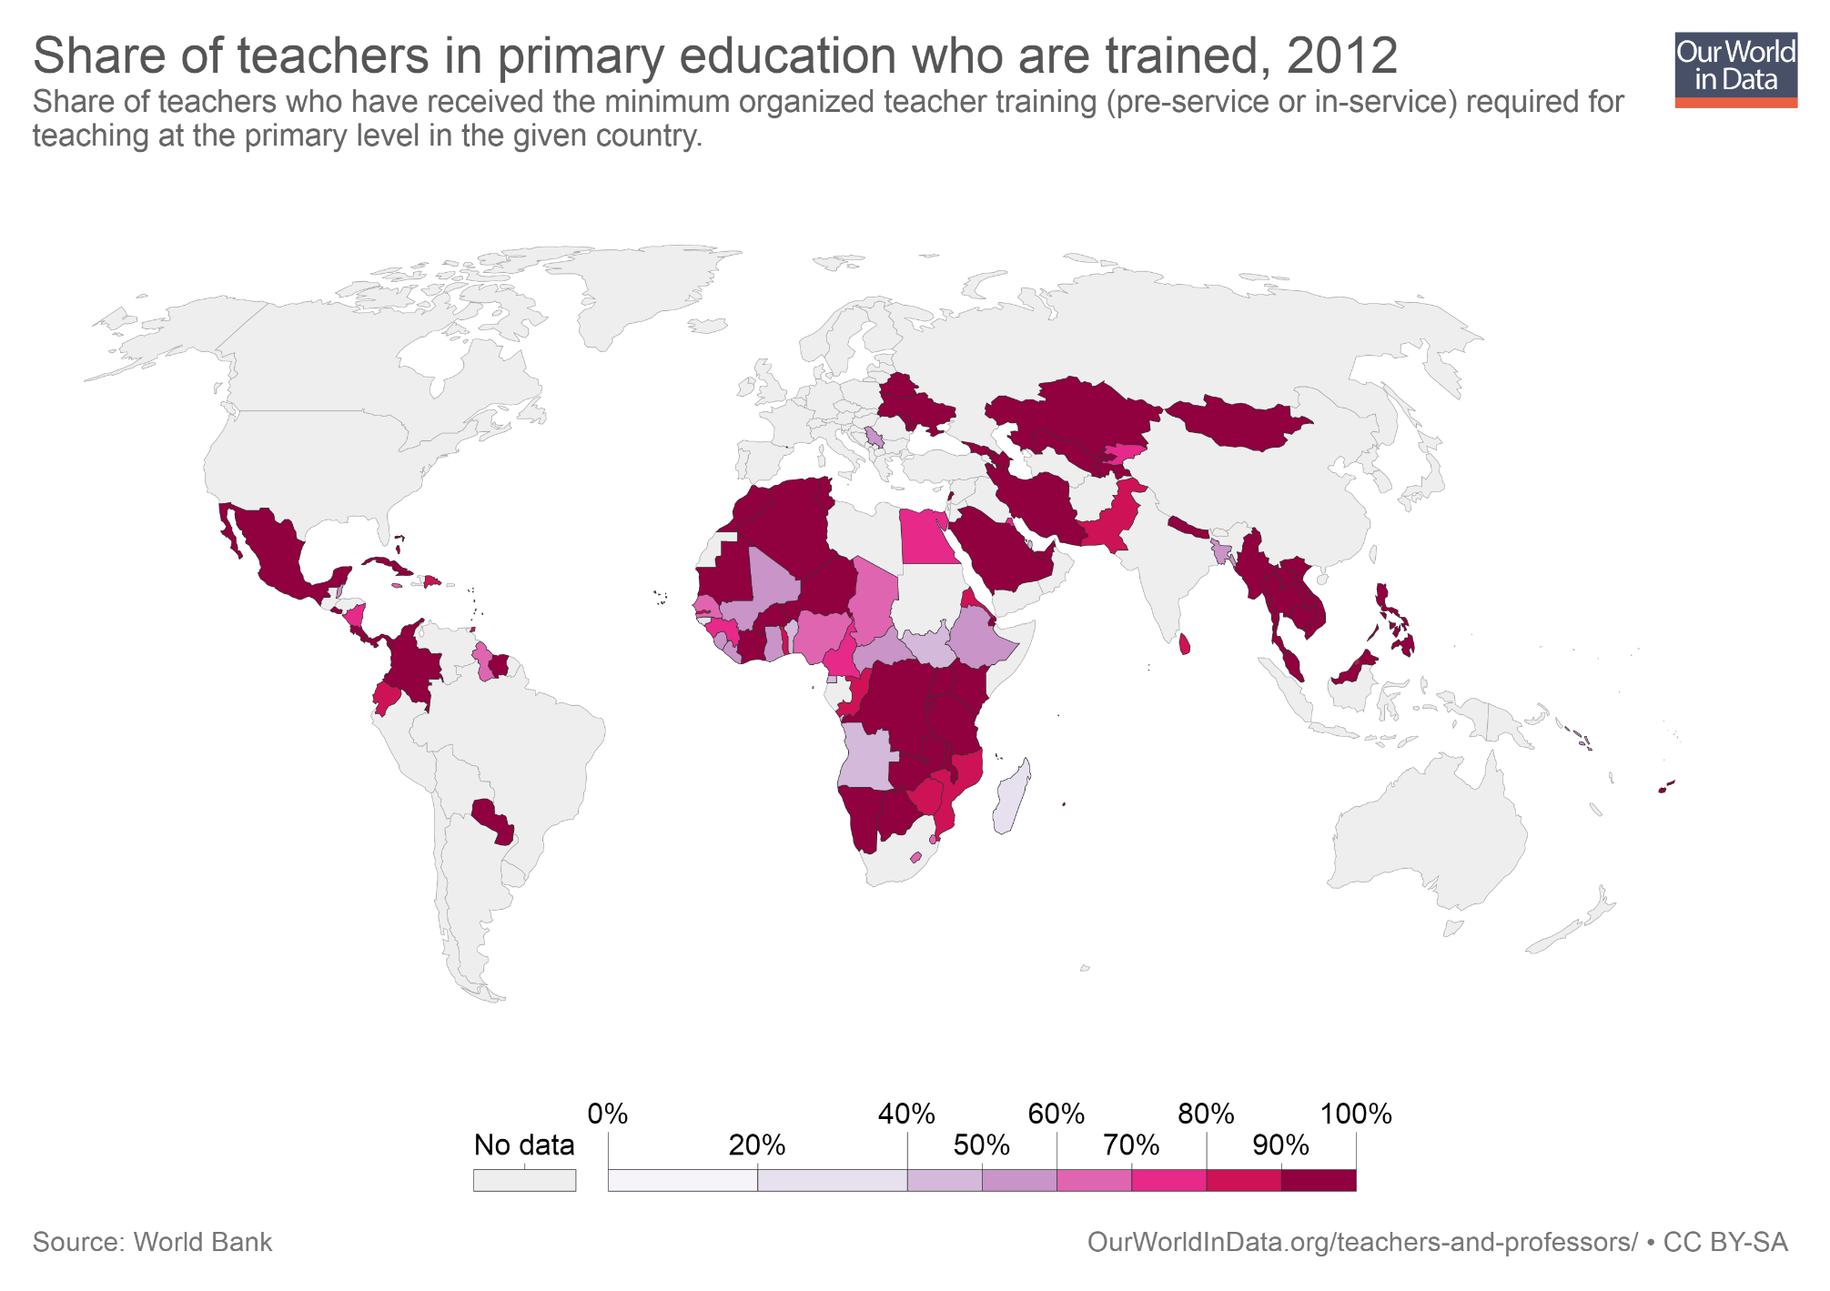
This map shows the proportion of primary school teachers who are trained to teach.
Although the data is patchy, this chart shows large gaps in some countries. In Ghana, for example, about half of the teachers lack the required pedagogical training.
(Note: Training gaps are also large if we look at subject-specific qualifications rather than general pedagogical training. You can read more about this in our entry exploring data on teacher characteristics).

Slide 28
Teachers and students are often absent from the classrooms

Slide 29
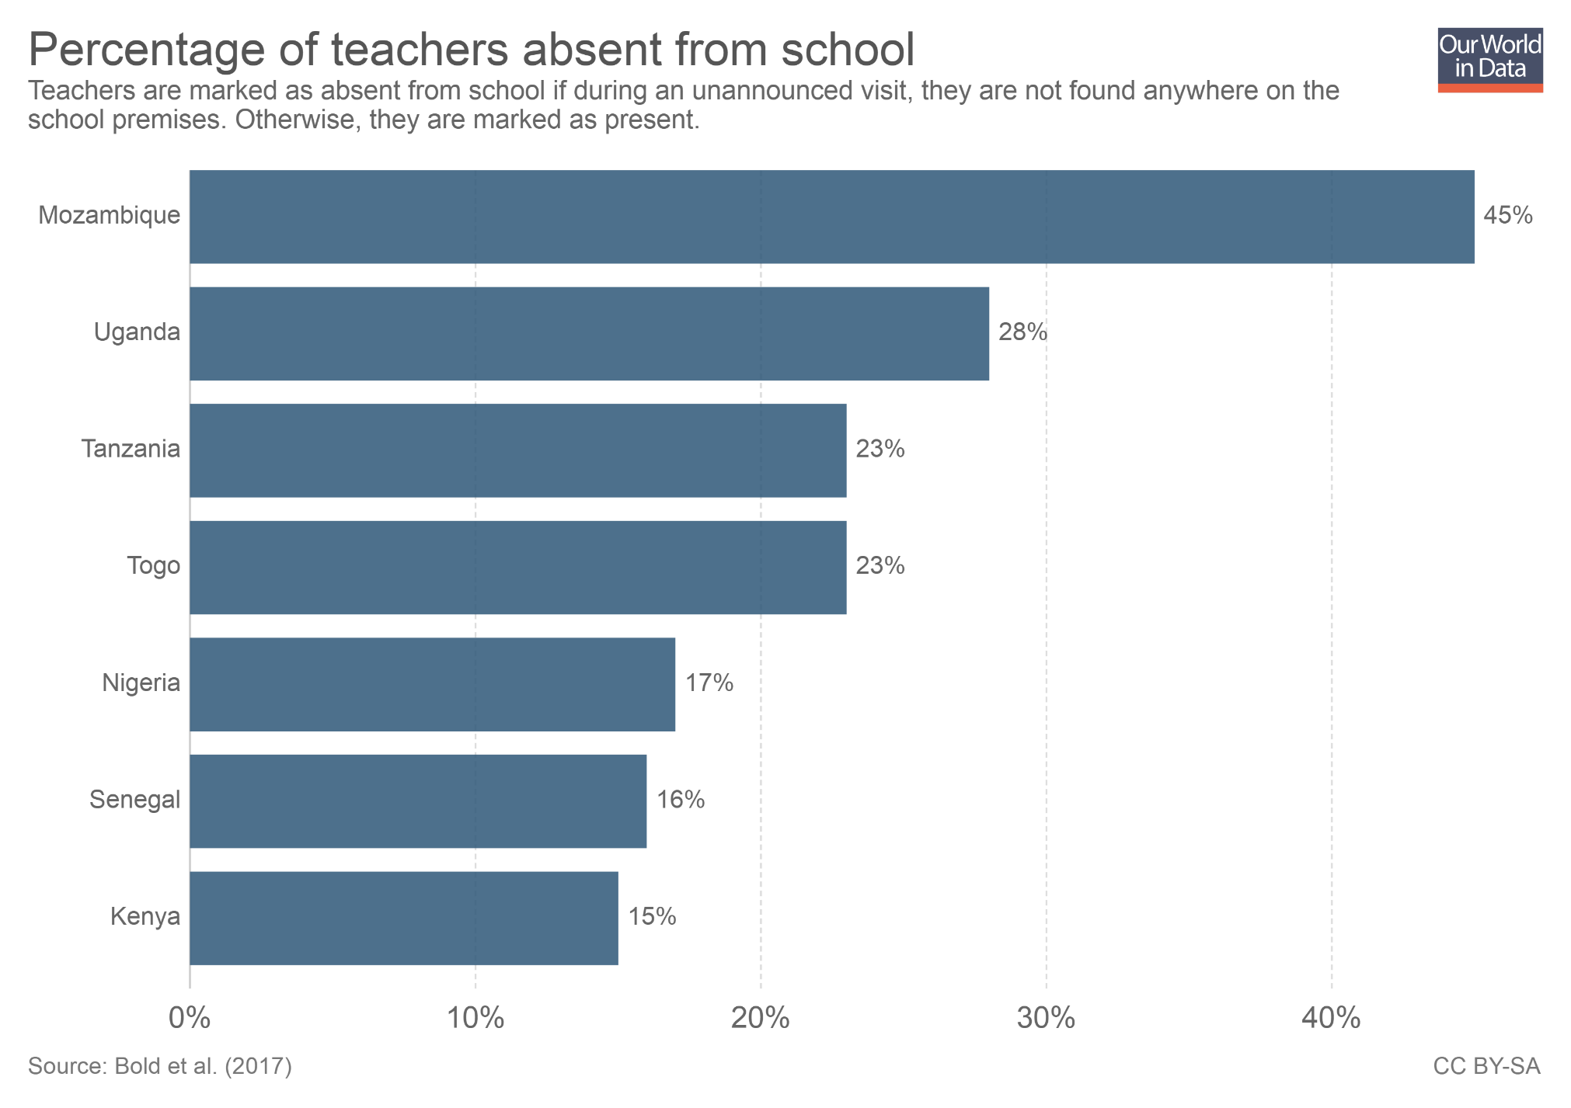
Random spot checks in schools across several African countries reveal that a large share of teachers are absent from schools.
Even when teachers are in the schools, the data shows that teachers are often absent from the classrooms.
This means that a substantial part of scheduled teaching time is often lost.

Slide 30
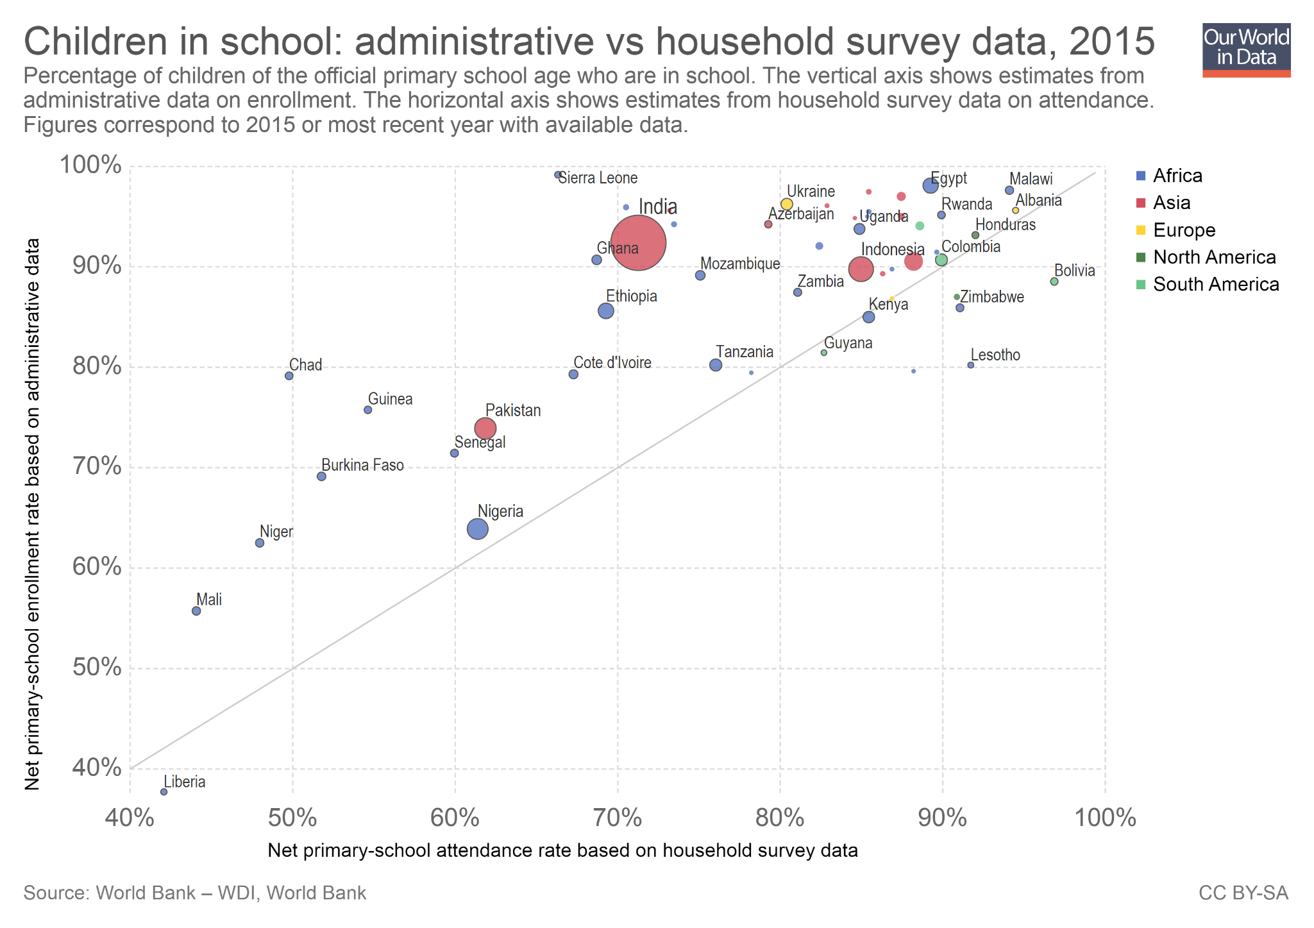
In most poor countries school enrollment estimates from administrative records are much higher than student attendance estimates from household surveys. This partly reflects the fact that student absenteeism is common and significant.
In Ghana, for example, the enrollment rate in 2015 was 90%, while the attendance rate was 69%.
In Niger, Chad, Mali and Liberia, attendance rates are below 50%.
(Note: Household surveys and administrative records are subject to measurement error. Because of this, the gap between enrollment and attendance is not a perfect measure of absenteeism. Indeed, as this chart also shows, in some countries attendance is higher than enrollment. )

Slide 31
Schools often lack adequate infrastructure

Slide 32
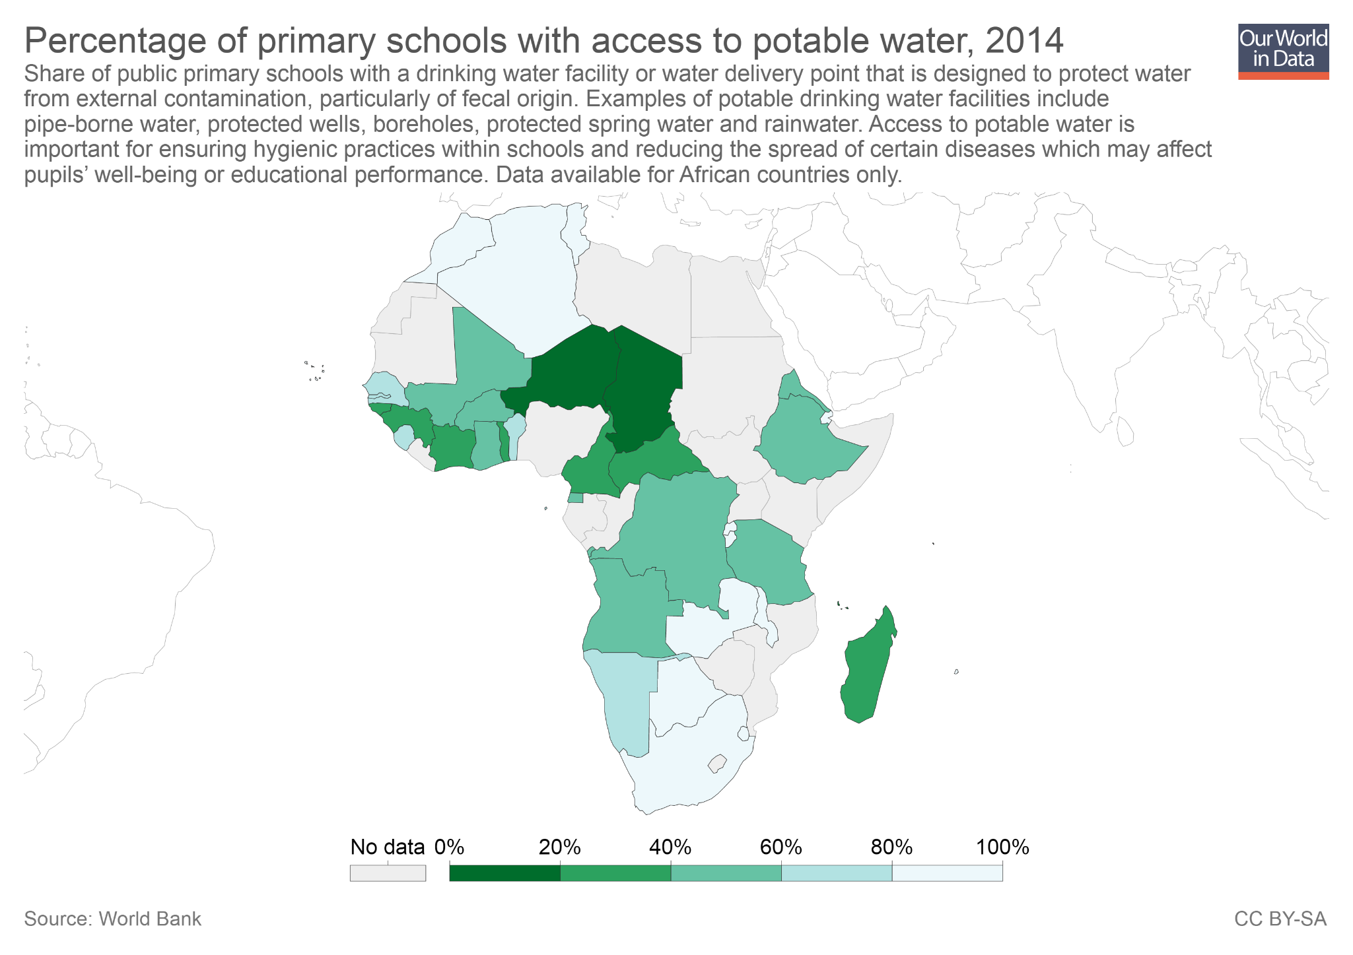
As this chart shows, in many African countries there is a large fraction of schools without access to potable water.
This is an important constraint if we consider that access to clean water affects health outcomes, and many children fail to attend school precisely because of poor health.
(Note: The source for this chart only publishes these estimates for African countries. To our knowledge there are no comparable estimates for other regions.)

Slide 33
What do these challenges mean in terms of policy?

Slide 34
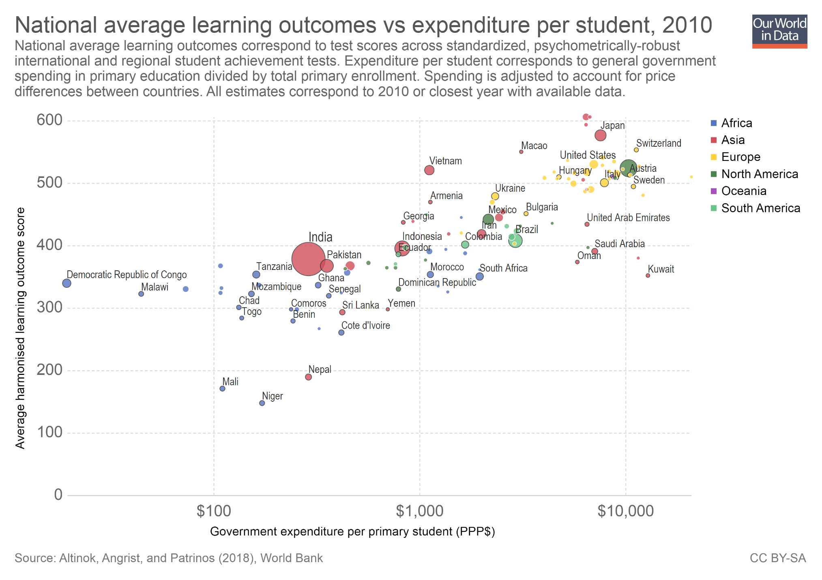
This chart plots learning outcomes against government education expenditure per primary-school student.
As we can see, there is a clear correlation: richer countries tend to have higher government expenditure per pupil, and they also tend to have higher learning outcomes.
Interestingly, however, this chart also shows that some countries achieve similar average test scores with radically different levels of spending. For example, South Africa and the Democratic Republic of Congo have similar average scores, but South Africa spends about 100 times more per student.
This shows that better education is not only about larger budgets.
(Note: You can read more about this in our entry on financing education)

Slide 35
The available evidence from policy experiments confirms that improving education quality requires thinking carefully about cost-effectiveness, and not only about budget size
"For policymakers, the main message from the summary of the evidence is that a “business as usual” approach of expanding spending on education (most of which is spent on increasing fairly standard inputs into education) is unlikely to have much impact on improving learning outcomes beyond that predicted by the cross-country relationship between per capita income and learning outcomes. On the other hand, interventions that focus on improved and more effective pedagogy (especially providing foundational literacy and numeracy skills to the millions of first-generation learners who are falling behind the pace of curriculum), and on improved governance of the education system (especially teacher performance and accountability) are likely to yield considerably greater returns on increased spending.“
(Glewwe and Muralidharan 2016, Page 85)

Slide 36
Further Resources from Our World in Data
A selection of key charts on global education
– ourworldindata.org/global-education-slides
Blog posts and data entries on this topic:
– ourworldindata.org/global-rise-of-education
– ourworldindata.org/financing-education
– ourworldindata.org/edu-quality-key-facts
– ourworldindata.org/literacy
– ourworldindata.org/pre-primary-education
– ourworldindata.org/primary-and-secondary-education
– ourworldindata.org/tertiary-education
– ourworldindata.org/teachers-and-professors
Teaching Notes for other topics:
ourworldindata.org/teaching-notes

Slide 37
About the author:
Esteban Ortiz-Ospina is an economist at the University of Oxford.
He is a Senior Researcher at the Oxford Martin Programme on Global Development.
About Our World in Data:
Our World in Data is an online publication that shows how living conditions are changing. The aim is to give a global overview and to show changes over the very long run, so that we can see where we are coming from, where we are today, and what is possible for the future.
www.ourworldindata.org/about | @eortizospina

